Slide 1
Shell Bootcamp 2024 3 Reflections for Week 1
Avni Tonger
Date : 28-Aug-2024

Slide 2

About Me
Love is the only thing that matters at all
Love for others, love for self, love for life
Everything else is just a distraction

Slide 3

My learnings from this week!

Slide 4

Learning 1 | Email Writing
Email writing is essential for clear and professional communication. It involves structuring messages effectively and using the right tone.
Key learning: The key learning is the importance of clarity and brevity in emails to ensure the message is understood.
Key takeaway: Well-written emails enhance communication efficiency and professionalism.
In the Energy sector, clear emails help coordinate projects and share critical updates efficiently

Slide 5

Learning 2 | Stakeholder management
Stakeholder management involves identifying and engaging with individuals or groups who have an interest in a project or organization. Effective stakeholder management ensures their needs and expectations are met.
Key learning: The importance of clear communication and building strong relationships with stakeholders to ensure project success.
Key takeaway: Engaging stakeholders effectively can lead to better project outcomes and increased support.
In the Energy sector, managing stakeholders is crucial for gaining approvals, ensuring compliance, and fostering collaboration on projects.

Slide 6
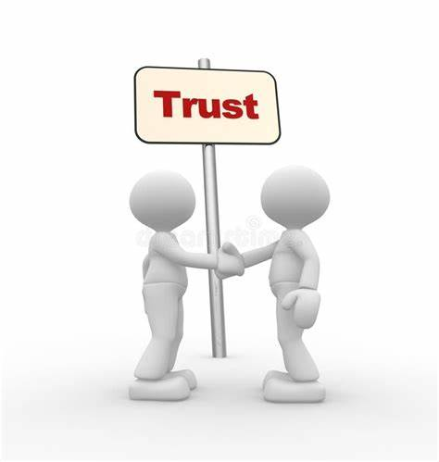
Learning 3 | Trust and Integrity
Trust and integrity are fundamental principles that guide ethical behavior and foster reliable relationships. They involve being honest, transparent, and consistent in actions and decisions.
The key learning is that maintaining trust and integrity builds credibility and strengthens relationships, both personally and professionally.
Upholding trust and integrity leads to a positive reputation and long-term success.
In the Energy sector, trust and integrity are crucial for ensuring safety, compliance, and fostering collaboration among stakeholders.

Slide 7

Relevance of learnings for my organization

Slide 8

Learning 1 | Relevance for Shell
How I feel Shell implements this learning (in your own words)
Emails are essential for a company
How I feel Shell benefits from this learning (in your own words)
Good emails ensure clear communication

Slide 9

Learning 2 | Relevance for Shell
How I feel Shell implements this learning (in your own words)
Stakeholders are important to have your priorities right

Slide 10

Learning 3 | Relevance for Shell
How I feel Shell implements this learning (in your own words)
With good HR policies
How I feel Shell benefits from this learning (in your own words)
Trust ensures safety and security. Integrity is essential to have a good work culture

Slide 11

Learning is also Fun!

Slide 12

Learning is also Fun!
We had a fun time doing a group activity about meeting etiquettes. The dos and don’ts on how to go about communicating in a work place.

Slide 13
Thank You

